Slide 1

Defensive Driving

Slide 2

Course Overview: Setting the Stage for Defensive Driving
Vehicle/Personal Safety
Equipment Check List
Proper Reporting
Damage Assessment
Notes:
Welcome to the beginning of our journey into Defensive Driving. In this session, we're going to lay the groundwork for what's to come in our subsequent discussions. This course is designed not just to inform but also to equip you with practical skills and knowledge for safer driving.
We'll start by focusing on vehicle and personal safety. It's crucial to understand how to ensure your vehicle is road-ready and how personal safety measures can significantly reduce risks while driving.
Next, we'll delve into the equipment checklist. This segment is designed to familiarize you with all the essential tools and communication devices you should have before embarking on any journey. These tools are vital for your safety and effectiveness on the road.
Proper reporting techniques will also be a key focus. We'll cover the nuances of what information is critical during a drive, how to effectively communicate it, and the protocols for reporting. This knowledge is essential for maintaining situational awareness and ensuring a timely response to any incidents.
Lastly, we'll cover damage assessment. This part of the course will teach you how to quickly and accurately assess your vehicle for any potential issues, as well as how to evaluate and respond to road situations you might encounter.
Each of these topics plays a crucial role in defensive driving. By the end of this course, you'll have a comprehensive understanding of these areas, preparing you for safer, more informed driving experiences.

Slide 3
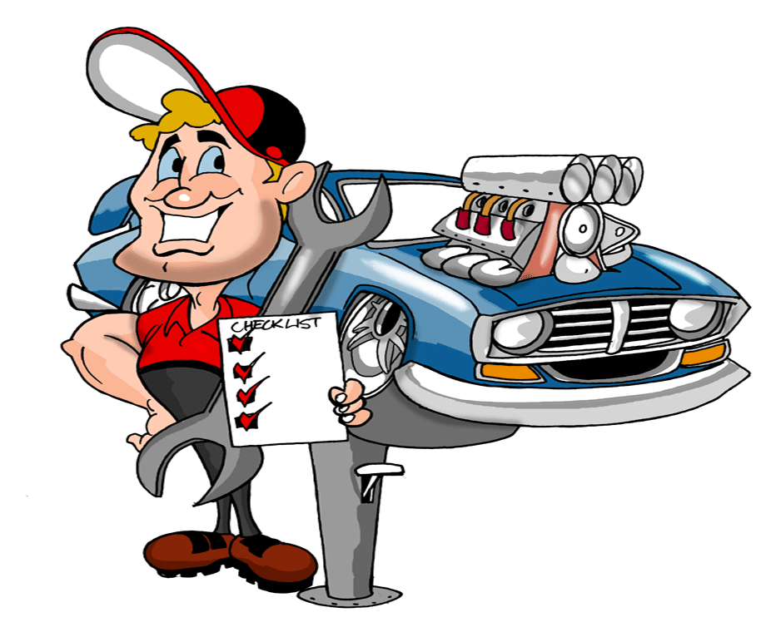
Pre-Drive Vehicle Inspection Checklist
Look under vehicle to check for any leaks
Walk around vehicle to check lights
Check antennas to insure they are secure
Check seat position
Adjust windshield mirror
Set side mirrors
Crack side window and listen
Start vehicle, look all directions and move
out slowly
Notes:
Before we set out on any journey, especially in the context of defensive driving, it's crucial to conduct a thorough pre-drive vehicle inspection. This process is a fundamental part of ensuring both our safety and the reliability of our vehicle.
First, take a moment to look under your vehicle. You're checking for any signs of leaks – oil, coolant, or other fluids. This can be an early indicator of potential mechanical issues.
Next, walk around your vehicle. This isn't just a cursory glance; you're inspecting all lights, including headlights, brake lights, and turn signals, to ensure they are functioning correctly. Visibility to others on the road is a key safety factor.
Then, check your antennas, especially relevant for those of us in amateur radio. Ensure they are securely attached and functioning, as they are vital for our communication needs.
Now, move to the inside of your vehicle. Adjust your seat to ensure you can comfortably reach all controls and have a clear view of the road. Then, adjust your windshield mirror for the best rear visibility.
Don't forget your side mirrors. Set them to minimize blind spots, which is critical for safe lane changes and turns.
Before you start the engine, crack open a side window. This allows you to listen to the sounds of your vehicle and your surroundings – an often-overlooked aspect of situational awareness.
Finally, start your vehicle. Take a moment to look in all directions, being aware of your surroundings, and then move out slowly. This measured approach to beginning your journey can make a significant difference in your safety and the safety of others on the road.

Slide 4
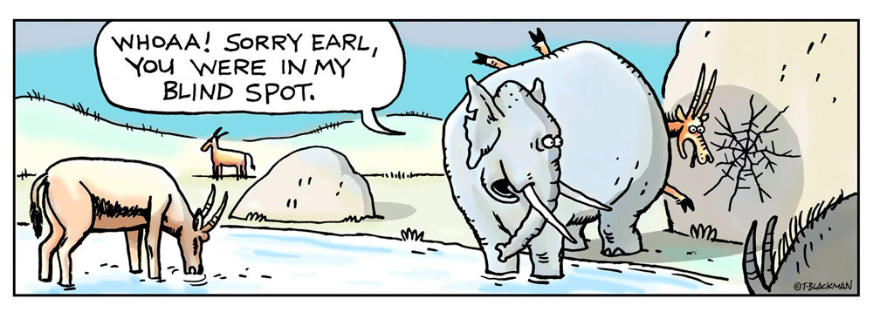
Optimizing Side Mirror Adjustment for Blind Spot Reduction
Adjust side mirrors to eliminate blind spots
Put left cheek to side window
Adjust left mirror until you see rear fender
Move to the right the same distance you moved to the left
Adjust right side mirror until you see the rear fender
You are in his/her blind spot when you can not see their rear view mirror
Traffic will now be in view of either the center mirror or the side mirror.
Notes:
An often-overlooked aspect of defensive driving is the proper adjustment of our vehicle's side mirrors. It's a simple yet crucial step in minimizing blind spots, significantly enhancing our safety on the road.
Let's break down the process. First, adjust your left side mirror. Sit in your driver's seat and put your left cheek close to the side window. From this position, adjust the left mirror until you can just see the edge of your car's rear fender.
Now, for the right mirror. Move your head to the right, maintaining the same distance from the center as when you leaned left. Adjust the right side mirror similarly until you see the rear fender on that side.
With this method, you maximize the field of vision provided by your side mirrors. This adjustment ensures that traffic transitions smoothly from your central rearview mirror to your side mirrors, greatly reducing those hazardous blind spots.
Remember, reducing blind spots is not just about enhancing your comfort; it's about making informed decisions on the road. By ensuring you have the best possible view of the traffic around you, you're taking a vital step in preventing accidents and driving defensively.

Slide 5

Driving Managing Tailgaters: Essential Safety Practices Tips
Tailgaters decrease your safe stopping distance.
Slow down gradually by tapping your brakes occasionally.
Notes:
In our journey of mastering defensive driving, understanding how to handle blind spots and tailgaters is crucial for our safety on the road. Let’s delve into these two important aspects.
Ltalk about tailgaters. These drivers decrease your safe stopping distance, potentially leading to rear-end collisions. If you find yourself in this situation, the key is not to brake suddenly. Instead, slow down gradually. Lightly tap your brakes occasionally to signal your intention to reduce speed. This not only alerts the tailgater but also encourages them to maintain a safer distance. Remember, our aim is to avoid confrontation and escalation. Sometimes, simply changing lanes and allowing a tailgater to pass is the safest course of action.
In summary, being aware of your blind spots and knowing how to deal with tailgaters are fundamental skills in defensive driving. They help us prevent accidents and ensure a safer driving experience for everyone on the road.

Slide 6
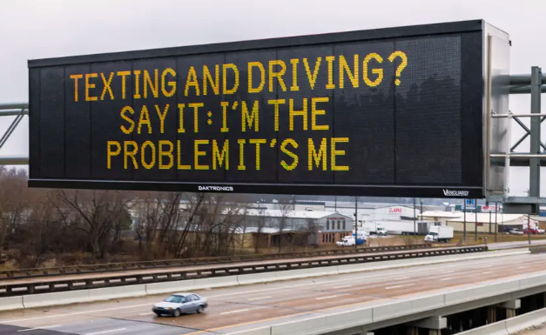
Essential Guidelines for Maintaining Safety on the Road
Urban Driving:
  Maintain a safe following distance:
  Typically 2 seconds behind the vehicle ahead.
  Increase to 3 seconds for drivers aged 50 and above.
  Always scan ahead for about 1 1/2 blocks, or 12 to 15 seconds.
Highway Driving:
  Keep a consistent following distance:
  2 seconds in general conditions.
  3 seconds for those aged 50 and above.
  Scan ahead approximately 1/4 mile, or 12 to 15 seconds.
General Safety Tips:
When stopping, ensure you can see the rear tires of the car in front on the road, not just in your mirror. This helps maintain a safe stopping distance.
Only pass another vehicle if you can see its front tires in your rearview mirror after passing. This confirms you have enough clearance.
When following trucks, ensure you can see the driver in his side mirror. If you can't, the truck driver cannot see you either, increasing the risk of accidents.
Notes:
Our goal is not just to react to situations, but to proactively prevent accidents through mindful driving practices.
Let's start with urban driving. In city conditions, maintaining a safe following distance is crucial. Aim for at least a 2-second gap between you and the vehicle ahead. For drivers aged 50 and above, increasing this gap to 3 seconds is advisable, providing additional reaction time. Consistently scanning ahead about 1 1/2 blocks, or 12 to 15 seconds, helps anticipate traffic changes and potential hazards.
Switching to highway driving, the following distance principle remains the same. Keep a consistent 2-second gap in normal conditions, and extend it to 3 seconds if you're 50 or older. The faster speeds on highways mean scanning further ahead, approximately 1/4 mile, to stay prepared for sudden changes.
Now, for some general safety tips applicable in all driving situations. A good rule of thumb when stopping is to ensure you can see the rear tires of the vehicle in front. This space provides a safety buffer. After passing another vehicle, don't merge back in front of it until you can see its front tires in your rearview mirror, confirming you have enough clearance. Finally, when following larger vehicles like trucks, always ensure you can see the driver in his side mirror. If you can't, it means the driver can't see you, and you're in a blind spot.
Remember, these defensive driving strategies are about making thoughtful, proactive decisions that enhance your safety and the safety of others on the road

Slide 7
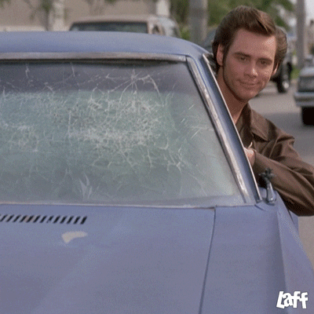
Highway Driving: Best Practices for Safety and Awareness Driving
Be visible use your lights when driving and hazard lights when parked.
  Use your turn signals
  Avoid unpaved roads
Don’t tell others what they need to be doing
  You are not their mother, keep it to yourself
Spotters are prone to sudden stops and starts, pay attention to the traffic around you.
  Park completely off the road, headed out.
  Report unsafe traffic and hazard conditions.
Notes:
When it comes to driving on the highway, especially in our capacity as spotters, certain practices are vital for maintaining safety and ensuring smooth operations. Here are some key points to keep in mind.
Firstly, visibility is paramount. Always use your vehicle’s lights while driving, especially in low-visibility conditions. When you're parked, especially on the side of the highway, make sure to turn on your hazard lights. This alerts other drivers to your presence and helps avoid accidents.
Using turn signals is not just a courtesy; it's a crucial communication tool. Signal your intentions well in advance to inform other drivers about your next move. This reduces the risk of collisions and improves traffic flow.
It's advisable to avoid unpaved roads where possible. These can present unpredictable driving conditions that may lead to vehicle damage or loss of control.
Remember, as a spotter, you are not there to police other drivers. Avoid the temptation to tell others what they should be doing. Focus on your own driving and safety.
Being a spotter often means sudden stops and starts, so it's important to be hyper-aware of the traffic around you. This means constantly checking your mirrors and being mindful of vehicles behind and beside you.
Always park completely off the road, preferably headed out. This positioning allows for a quick and safe exit if needed.
Lastly, it's important to report any unsafe traffic or hazardous conditions you encounter. This information can be crucial for the safety of other drivers and emergency responders.
Remember, our role as spotters on the highway is to observe and report while ensuring our own safety and the safety of others. These practices are fundamental in fulfilling that role responsibly.

Slide 8
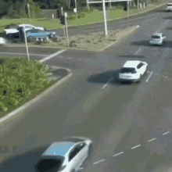
Responsibility as an RACES and SCEM Member
Keep in mind that your actions do portray RACES and Sedgwick County Emergency Management as a whole.
  Do not behave recklessly.
  Keep in mind the safety and well-being of others.
  Be courteous.
Don’t let spotting get in the way of any work responsibilities.
Spotters are not storm chasers or thrill-seekers.

Slide 9

Questions?
Notes:
Thank you all for your attentive participation in our 'Defensive Driving' presentation. We've covered a range of vital topics today, from the importance of pre-drive vehicle checks to the nuances of highway driving, and the best practices for managing blind spots and dealing with tailgaters. Each of these elements plays a crucial role in enhancing our safety on the road, especially in our capacity as members of the Sedgwick County R.A.C.E.S.
As we conclude, I'd like to open the floor for any questions you might have. This is your opportunity to seek clarification, share experiences, or discuss any aspect of defensive driving that you'd like to explore further. Your questions are valuable, not just for your understanding but for the benefit of the entire group. They help us all gain a deeper insight into the best practices of safe driving.
Please, feel free to ask any questions you have now. If you think of something later, or prefer a one-on-one discussion, I am available after the presentation as well. Your safety and confidence on the road are our top priorities, and we're here to support you in any way we can.
So, let's hear your questions, thoughts, or any points you'd like to discuss further.

